Slide 1
Waste classification using Computer Vision👀
Group 6
[ Nipun Haldar, Rahul Hebbar, Hargovind Singh ]
Mentor - Dr. M. Senthil Sivakumar

Slide 2
The project can be found at this GitHub link:
🔗https://github.com/nipun24/waste-classification

Slide 3
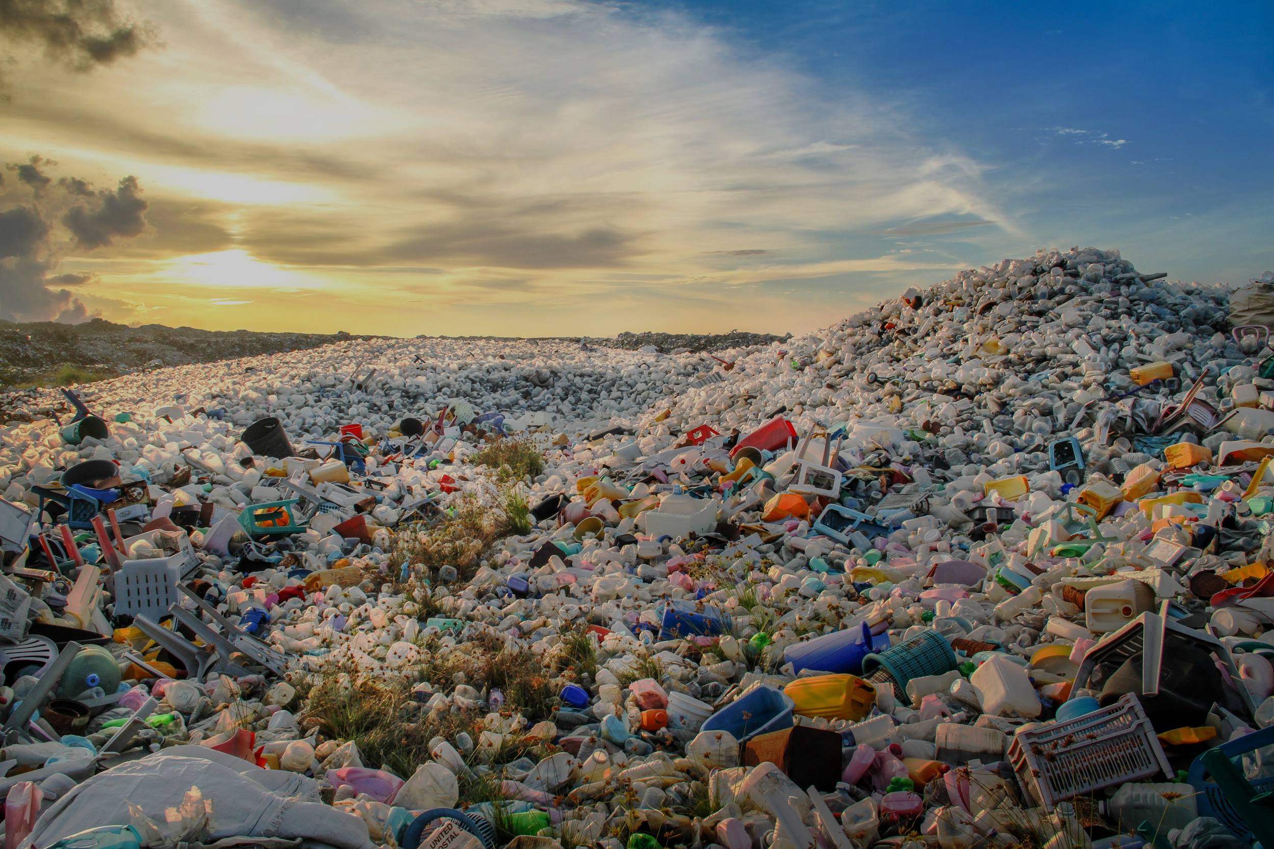
ABSTRACT
Waste management is one of the primary problem that the world faces irrespective of the case of developed or developing country.
For eliminating or mitigating the garbage’s and maintains the cleanness, it requires smartness based waste management system.
There are three main reasons for this:
In IoT applications,
Computer systems can learn to perform tasks, such as classification, clustering, predictions, and pattern recognition.
Feature extraction on the large amount of data generated
This project aims to understand the use of machine learning, artificial intelligence and IoT in the most potential areas and the ultimate need to completely replace the human interaction. Machine learning (ML) provides effective solutions, such as regression, classification, clustering, and correlation rules perception for IoT-based waste management.

Slide 4

Existing Work

Slide 5
Y. Lecun, L. Bottou, Y. Bengio and P. Haffner, "Gradient-based learning applied to document recognition," in Proceedings of the IEEE, vol. 86, no. 11, pp. 2278-2324, Nov. 1998, doi: 10.1109/5.726791.
Multilayer neural networks trained with the back-propagation algorithm constitute the best example of a successful gradient based learning technique.
Given an appropriate network architecture, gradient-based learning algorithms can be used to synthesize a complex decision surface that can classify high-dimensional patterns, such as handwritten characters, with minimal preprocessing.
Convolutional neural networks, which are specifically designed to deal with the variability of 2D shapes, are shown to outperform all other techniques.
A new learning paradigm, called graph transformer networks (GTN), allows such multi module systems to be trained globally using gradient-based methods so as to minimize an overall performance measure.
A graph transformer network for reading a bank cheque is also described. It uses convolutional neural network character recognizers combined with global training techniques to provide record accuracy on business and personal cheques. It is deployed commercially and reads several million cheques per day.
URL: https://ieeexplore.ieee.org/stamp/stamp.jsp?tp=&arnumber=726791&isnumber=15641

Slide 6
T. Guo, J. Dong, H. Li and Y. Gao, "Simple convolutional neural network on image classification," 2017 IEEE 2nd International Conference on Big Data Analysis (ICBDA), Beijing, 2017, pp. 721-724, doi: 10.1109/ICBDA.2017.8078730.
In recent years, deep learning has been used in image classification, object tracking, pose estimation, text detection and recognition, visual saliency detection, action recognition and scene labeling.
Among different type of models, Convolutional neural networks has been demonstrated high performance on image classification.
In this paper we builded a simple Convolutional neural network on image classification.
On the basis of the Convolutional neural network, we also analyzed different methods of learning rate set and different optimization algorithm of solving the optimal parameters of the influence on image classification.
URL: https://ieeexplore.ieee.org/stamp/stamp.jsp?tp=&arnumber=8078730&isnumber=8078675

Slide 7
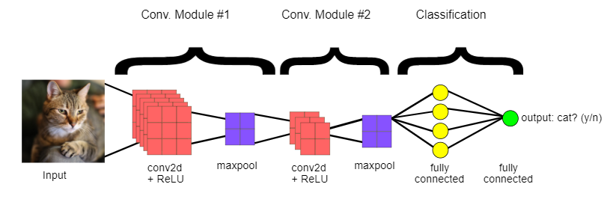
Introduction
Designing a Convolutional neural network that will be a fully capable of classifying images of waste products as either organic or recyclable.
In final step would be to integrate this with an IoT platform.

Slide 8






Tools and Software used
Python (language used)
Kaggle (Training data - https://www.kaggle.com/techsash/waste-classification-data )
Tensorflow (open source platform for machine learning)
Tensorboard (visualization toolkit integrating tensorflow)
Google Colab (google’s cloud platform with high compute including GPUs)
Visual Studio Code (text editor for local machine)
GitHub (version control)

Slide 9




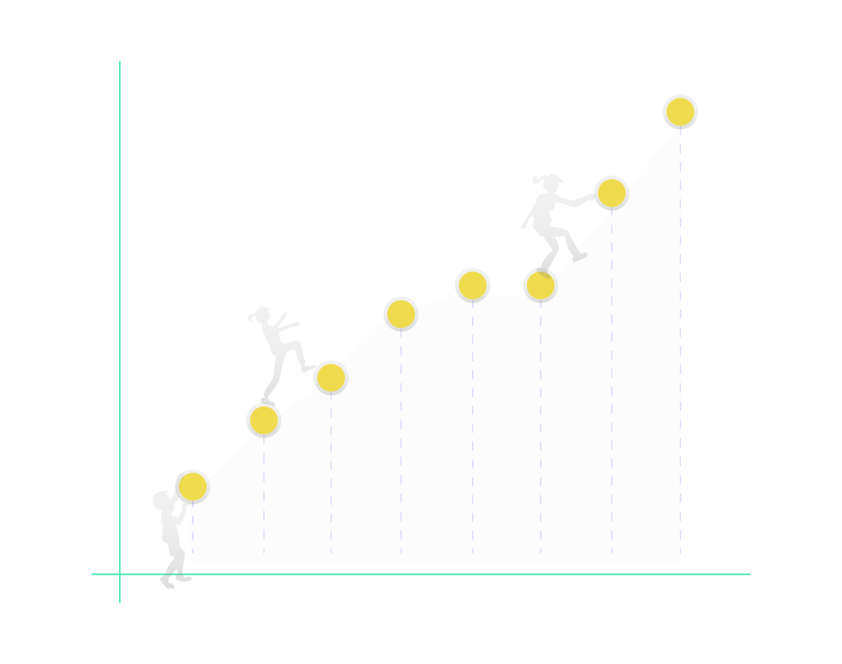
Software Working Flow
Import the images
Data preprocessing
Building the model
Evaluating the model
Training the model

Slide 10
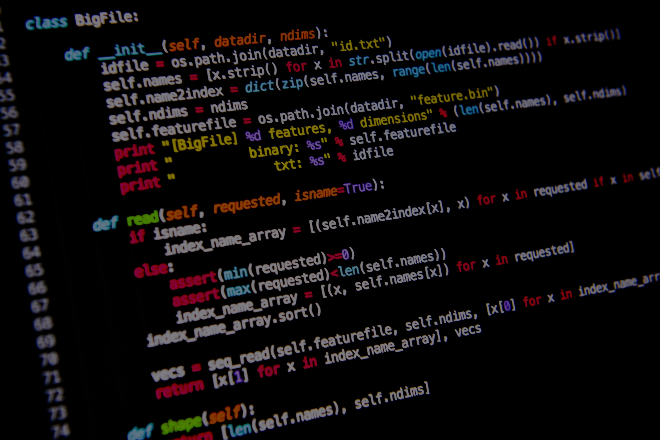
Code Walkthrough
Just 50 lines of code to achieve ~88% accuracy on an augmented dataset of 2,50,000 images!

Slide 11
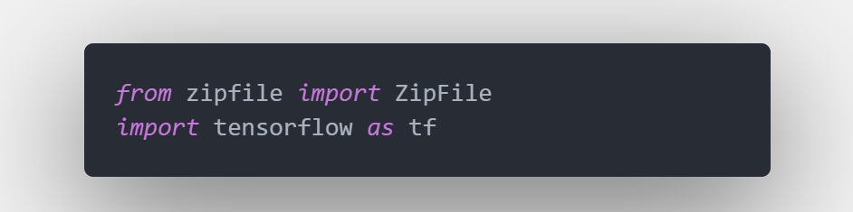
Importing libraries
zipfile : extract the dataset
tensorflow : preprocessing, data augmentation, building the neural network

Slide 12
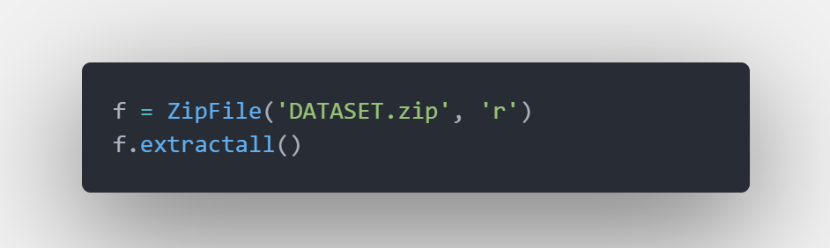
Extracting the dataset
Create a ZipFile object and extract the Dataset

Slide 13

Underfitting and Overfitting

Slide 14
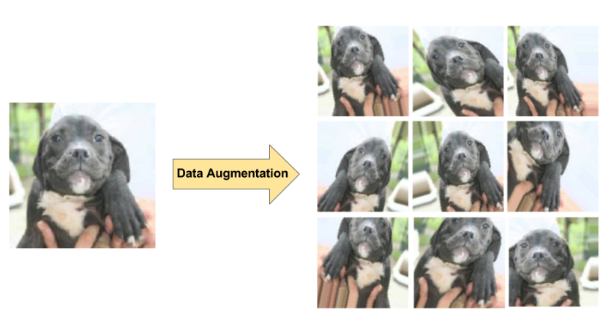
Data Augmentation

Slide 15
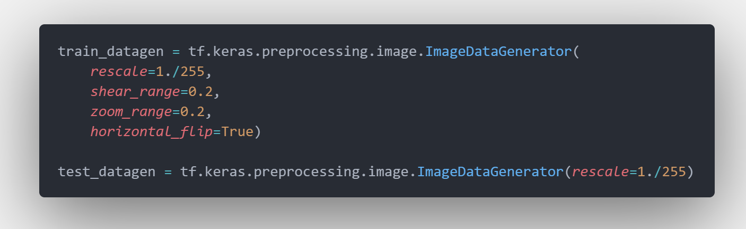
Creating a image augmentor instance
ImageDataGenerator generates batches of tensor image data with real-time data augmentation.
train_datagen : generates batches of images with shear, zoom and flips randomly.
test_datagen : generates batches of images and normalizes the pixel values.

Slide 16
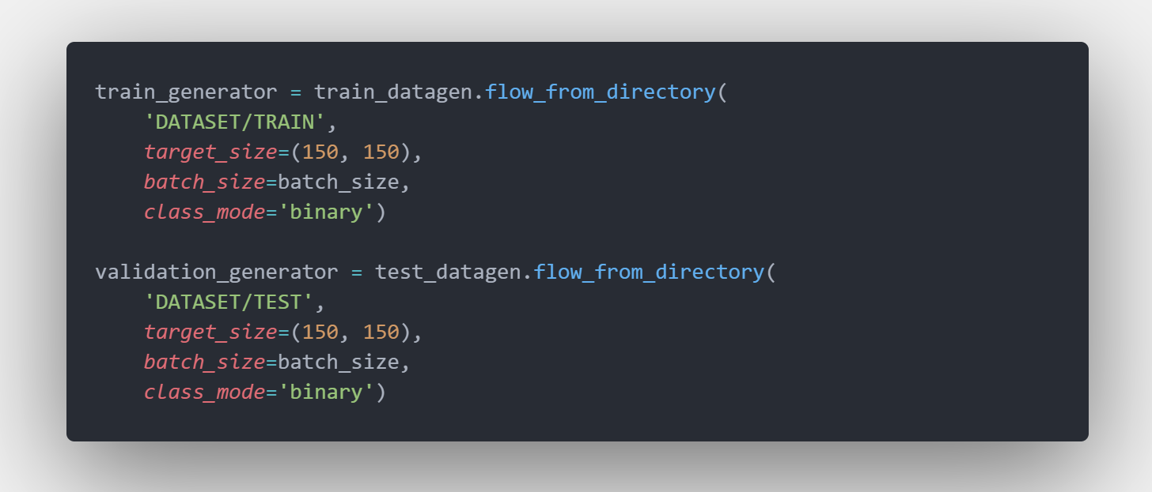
Getting images from dataset
Generating batches of images using the flow_from_directory method provided by keras using the train_datagen and test_datagen object created previously. The images are resized to 150x150 and binary classes are assigned to them.

Slide 17
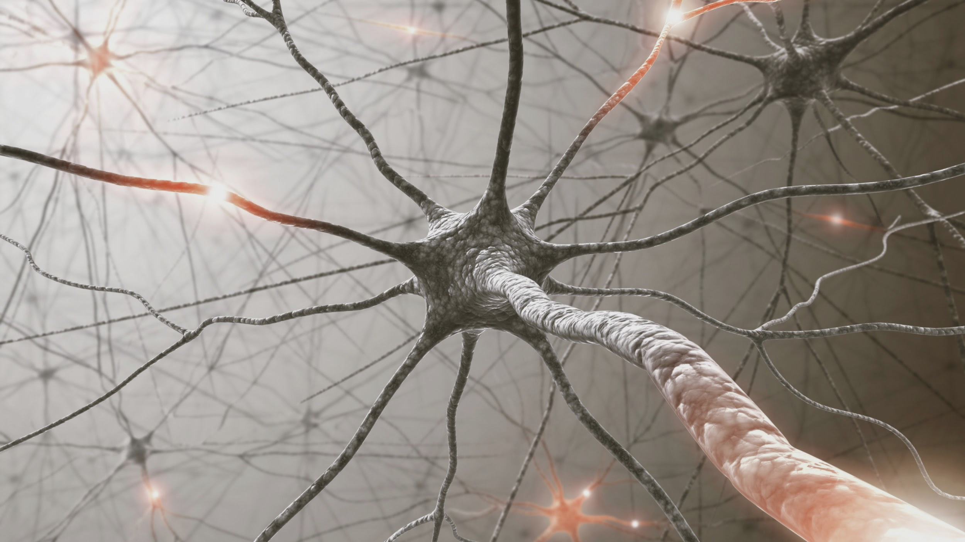
Building Convolutional Neural Network
Convolutional Layers
Dense Layers

Slide 18
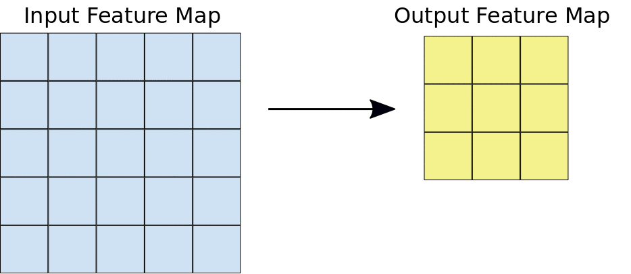
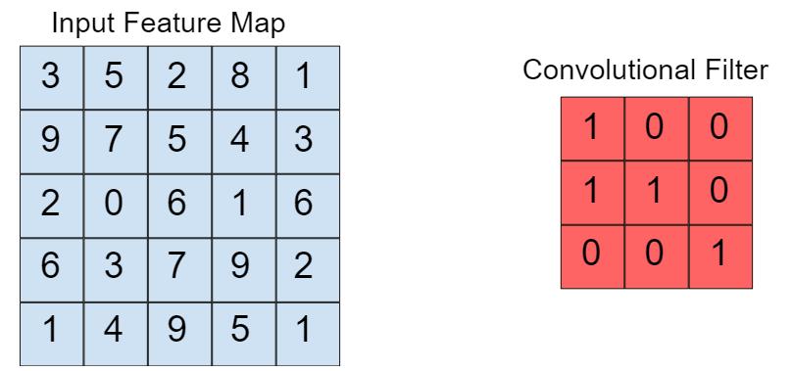
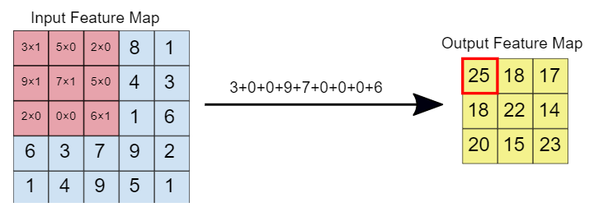
Working of Convolutional layer

Slide 19
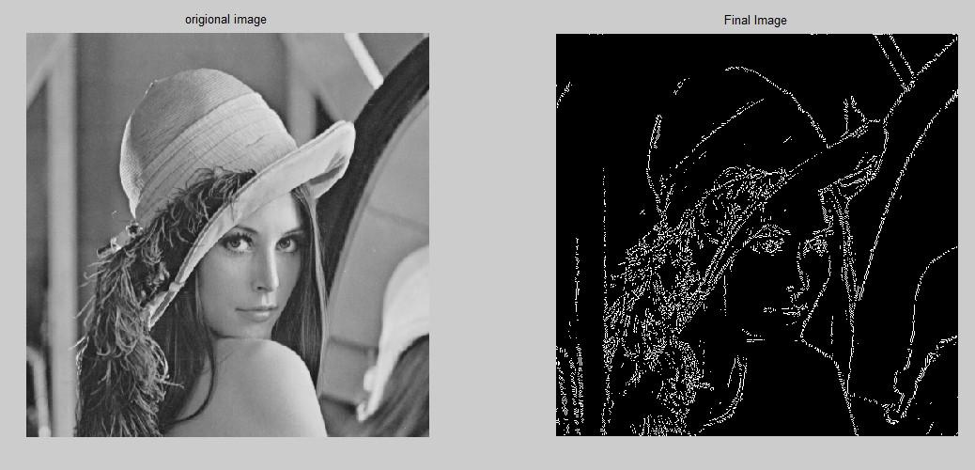
Convolutional Kernel Example
(Edge Detection)

Slide 20

Working of Max Pooling Layer

Slide 21

Activation Functions

Slide 22
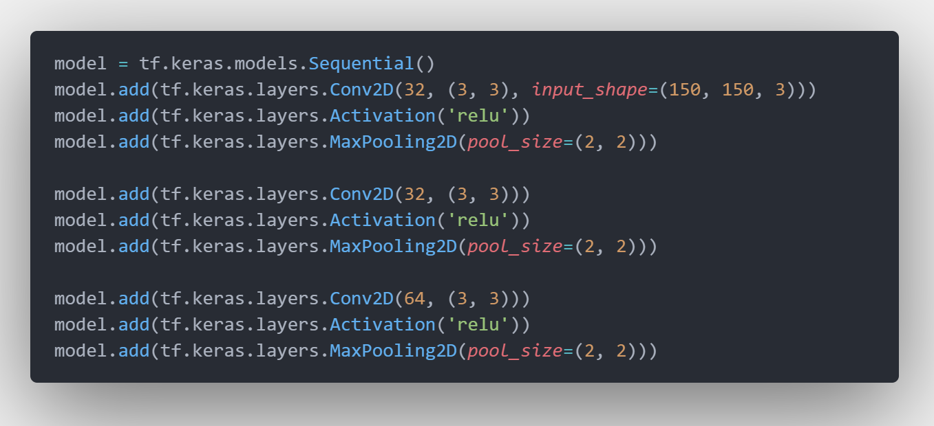
Convolutional layers
Convolutional Layers are great at extracting features from images.
Conv2D : creates a convolution kernel that is convolved with the layer input to produce a tensor of outputs.
Maxpooling2D : Downsamples the input representation by taking the maximum value over the window
Activation : ReLU (Rectified Linear Unit) activation function is used to activate the convolutional layers

Slide 23

Working of Dense Layers

Slide 24
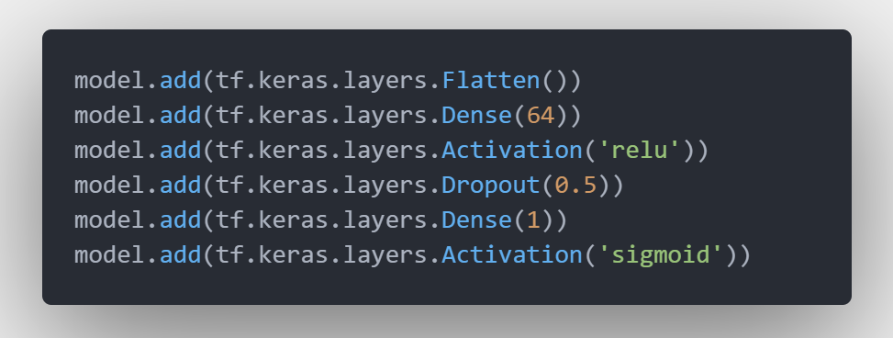
Dense layers
The convolutional layers are good for extracting features from images but they cannot recognising objects. For this traditional neural networks works best. So, dense layers are used after convolutional layers in a CNN.
Flatten : flattens the 3D matrix from the convolution layers to 1D matrix.
Dense : fully connected layers
Dropout : reduce overfitting
Activation : ReLU activation is used for dense layers. Sigmoid activation is used for the output layer.

Slide 25
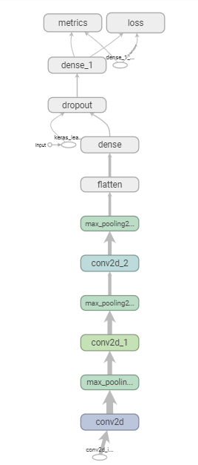
Structure of the Neural Network (Top-Down)

Slide 26
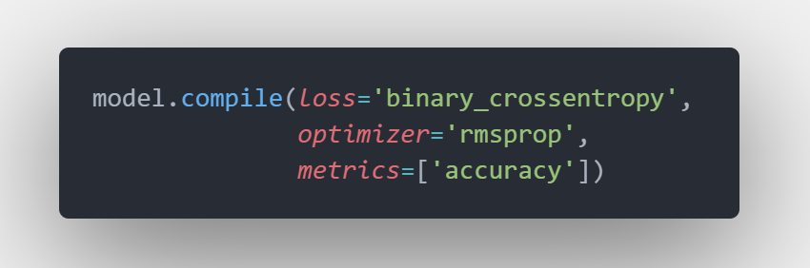
Compiling the model
Configuring the model with loss and metrics for training. The weights of neurons are randomly initialized.
Loss Function : binary cross entropy, as the number of outputs is two.
Optimizer Function : RMSprop, task is not complex enough

Slide 27
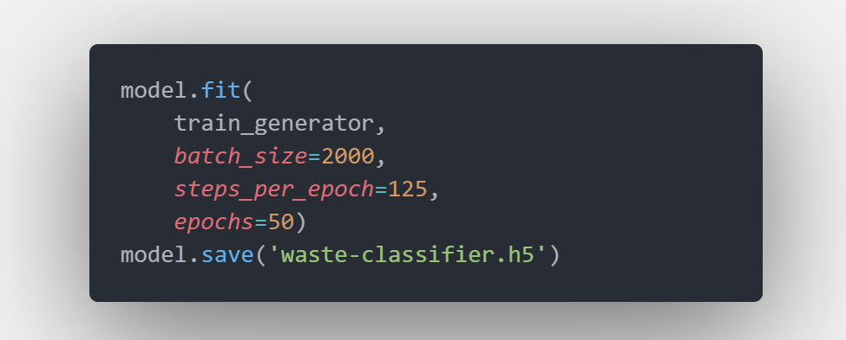
Training model and saving layer and weights
fit method is used to train the model on the training set. The model is trained for 50 epochs.
The model is saved for future use.

Slide 28
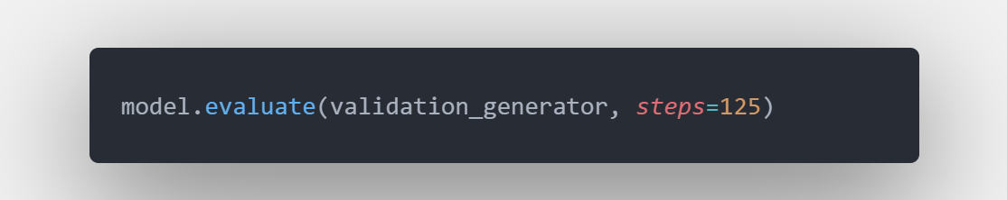
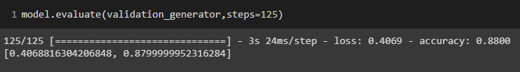
Evaluating our model
evaluate method passes all the test images through the model created and compares the predicted label with actual known label of the image and then calculates the accuracy of the model. (about 88% accuracy)

Slide 29
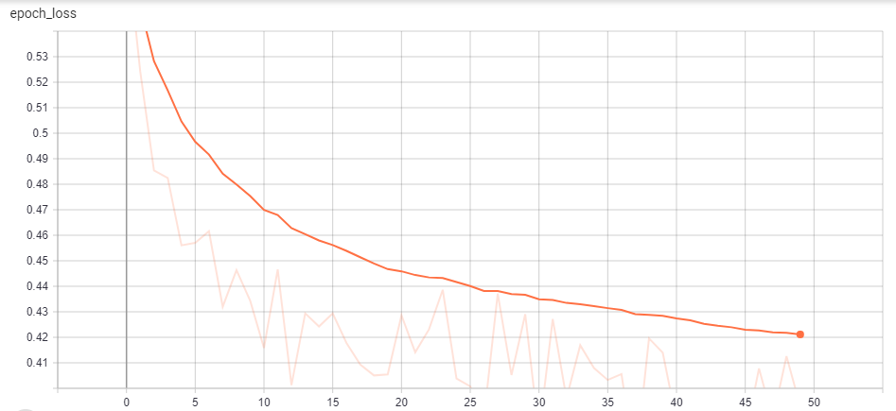
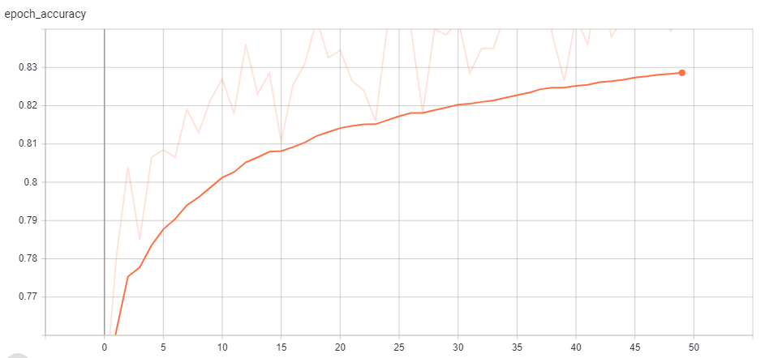
Loss and Accuracy graph during training
Loss at each epoch
Accuracy at each epoch

Slide 30
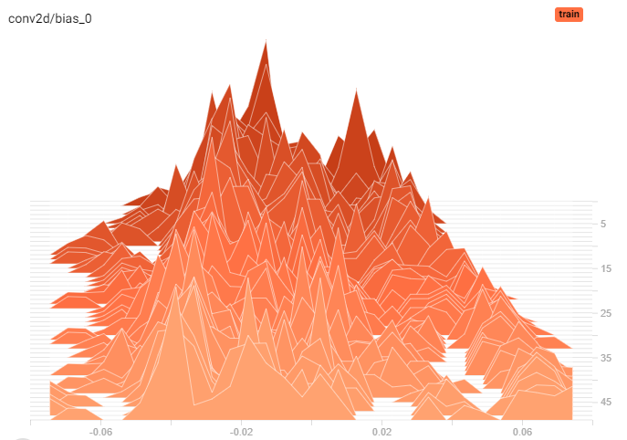
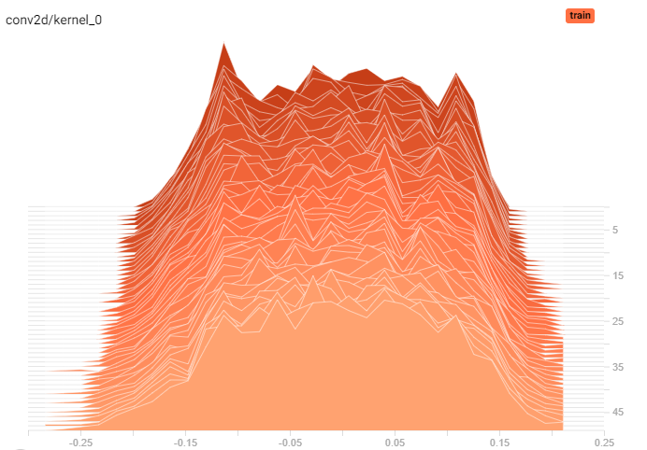
Input Convolutional Layer Histogram

Slide 31
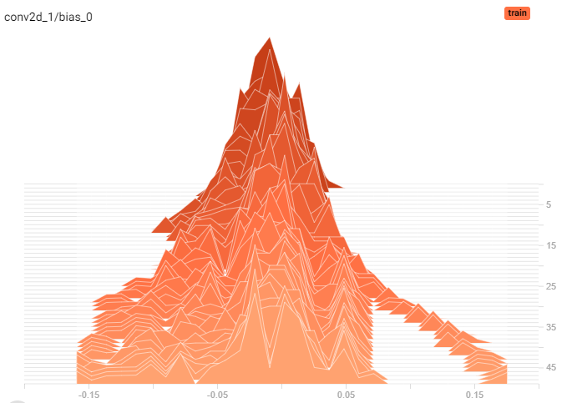
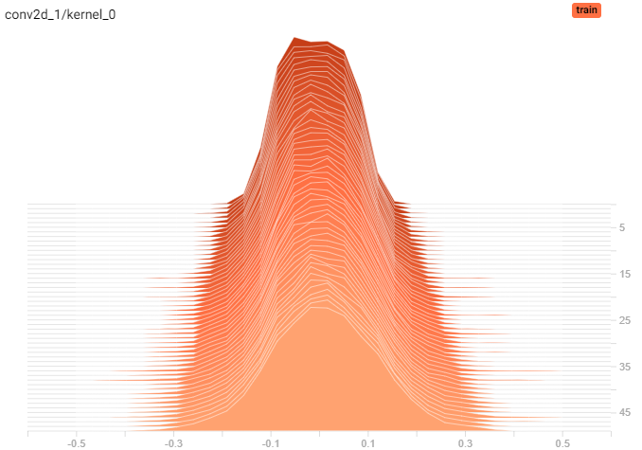
Hidden Convolutional Layer #1 Histogram

Slide 32
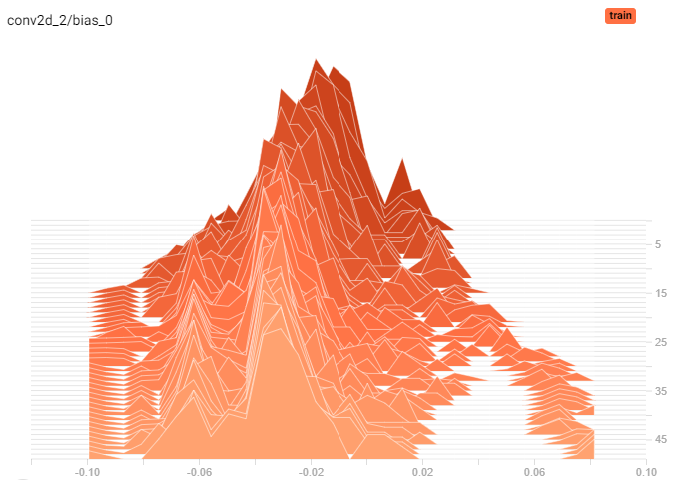
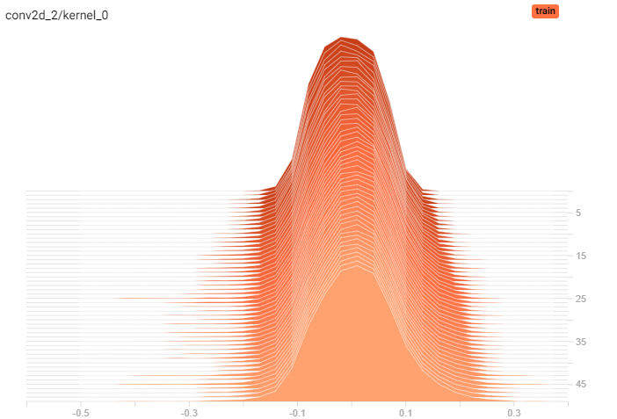
Hidden Convolutional Layer #2 Histogram

Slide 33
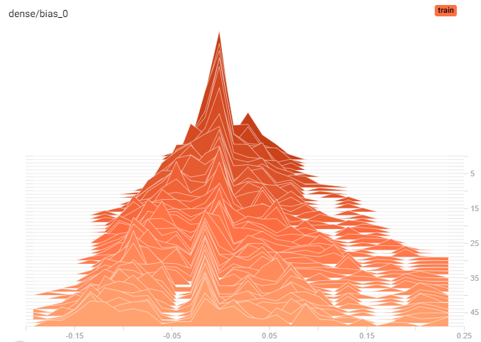
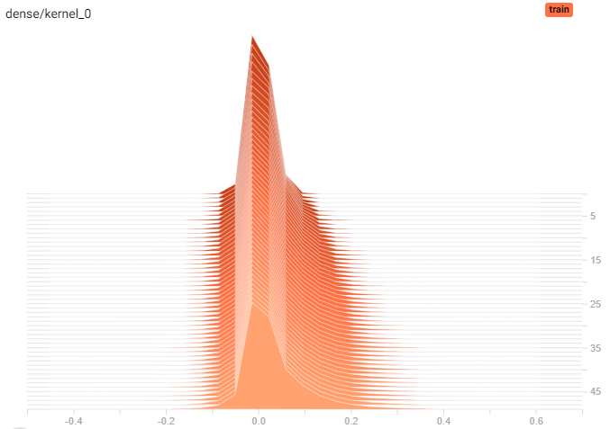
Hidden Dense Layer Histogram

Slide 34
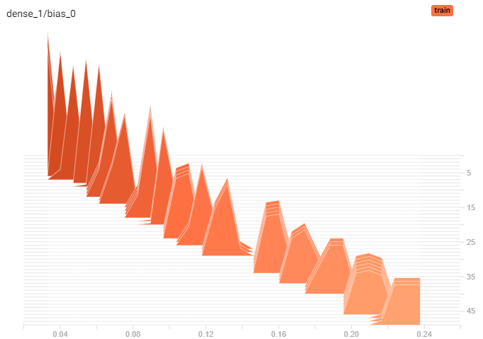
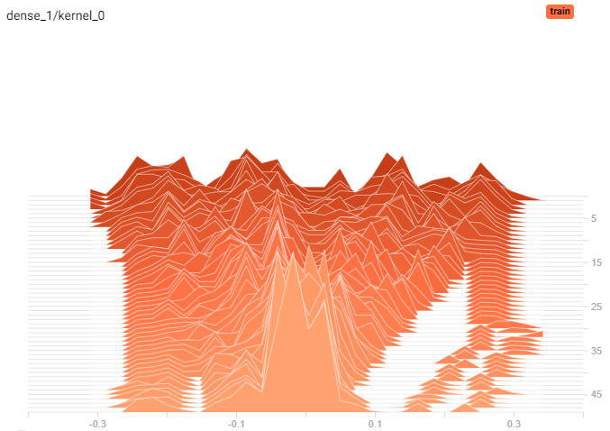
Output Dense Layer Histogram

Slide 35
For the next Review!
Implement a model to classify images using transfer learning.
Create a IoT hardware that will run the classifier.

Slide 36
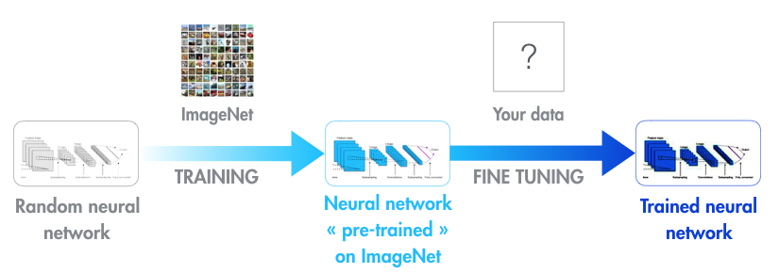
Transfer Learning

Slide 37
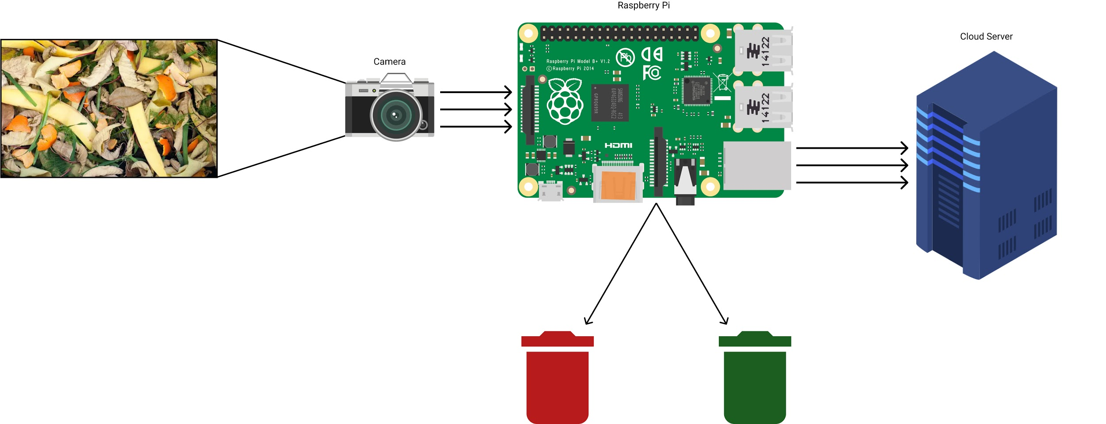
Hardware and software integration

Slide 38
📑References
IEEE PAPERS -
Y. Lecun, L. Bottou, Y. Bengio and P. Haffner, "Gradient-based learning applied to document recognition," in Proceedings of the IEEE, vol. 86, no. 11, pp. 2278-2324, Nov. 1998, doi: 10.1109/5.726791.
N. Jmour, S. Zayen and A. Abdelkrim, "Convolutional neural networks for image classification," 2018 International Conference on Advanced Systems and Electric Technologies (IC_ASET), Hammamet, 2018, pp. 397-402, doi: 10.1109/ASET.2018.8379889.
T. Guo, J. Dong, H. Li and Y. Gao, "Simple convolutional neural network on image classification," 2017 IEEE 2nd International Conference on Big Data Analysis (ICBDA), Beijing, 2017, pp. 721-724, doi: 10.1109/ICBDA.2017.8078730.

Slide 39
🌍Additional References
URL’s -
https://www.tensorflow.org/tutorials/images/cnn
https://www.tensorflow.org/tutorials/images/classification
https://blog.keras.io/building-powerful-image-classification-models-using-very-little-data.html
https://www.tensorflow.org/tensorboard/get_started
https://www.kaggle.com/techsash/waste-classification-data
https://developers.google.com/machine-learning/practica/image-classification/convolutional-neural-networks

Slide 40
🙏Thank You🙏
#staysafe

